Slide 1
How to use Generative AI to
discover, analyze and respond faster to threats
Sergio Pilla | spilla@tenable.com
Security Engineer

Slide 2
ORGANIZATIONS ARE UNDER SIEGE WITH EXPOSURES
New domains created every minute
New hosts created every minute
New CVE’s published every week
600
117K
480
Increase OT attacks in 2023
AD accounts attacked each day
95%
95M
Do you have adequate resources? | How do you prioritize and conquer? | Are you continuously reacting?

Slide 3
In what ways can AI provide more efficiency and productivity
for Preventive Security?

Slide 4
AI is only as good as its Data Sources
Tenable Exposure Graph
he world's largest repository of exposure data and context
propelling your exposure management program
1T
Unique counts of threat, vuln and asset data
1B
Assets
60B
Threat Artifacts
800M
Security Configs

Slide 5
Tenable has been a leader in AI-based cybersecurity
Vulnerability Priority Rating February 2019 | OS Prediction January 2020 | Predictive Scoring October 2020 | Gen AI Research Tools April 2023 | Identity Exposure June 2023
ML-based algorithms identify vulnerabilities most likely to be exploited in the next 28 days, analyzing each vulnerability daily to predict the likelihood of an exploit actually being used against it. | ML-based algorithms predict an unauthenticated asset's operating system via host response to TCP packet data to increase assessment and inventory accuracy. | ML-based algorithms predict an asset's risk from limited, unauthenticated scan data using data derived from authenticated scans and exposure characteristics of similar assets. | Four new tools developed by Tenable Research that create efficiencies in processes such as reverse engineering, code debugging, web app security and visibility into cloud-based tools. | Several identity-aware features that harness the power of artificial intelligence (AI) and machine learning to provide a unified view of all user identities and entitlement risks, whether on-prem or in the cloud.

Slide 6
It’s all about levels - Artificial Intelligence
Artificial Intelligence
Artificial intelligence (AI) discipline of applying advanced analysis and logic-based techniques, including machine learning (ML), to interpret events, support and automate decisions and to take actions. Machine learning is a purely analytical discipline. It applies mathematical models to data to extract knowledge and find patterns that humans would likely miss. Generative AI learns about artifacts from data and generates innovative new creations that are similar to but don’t repeat the original
(A subset of Deep Learning)
Machine Learning
Generative AI

Slide 7
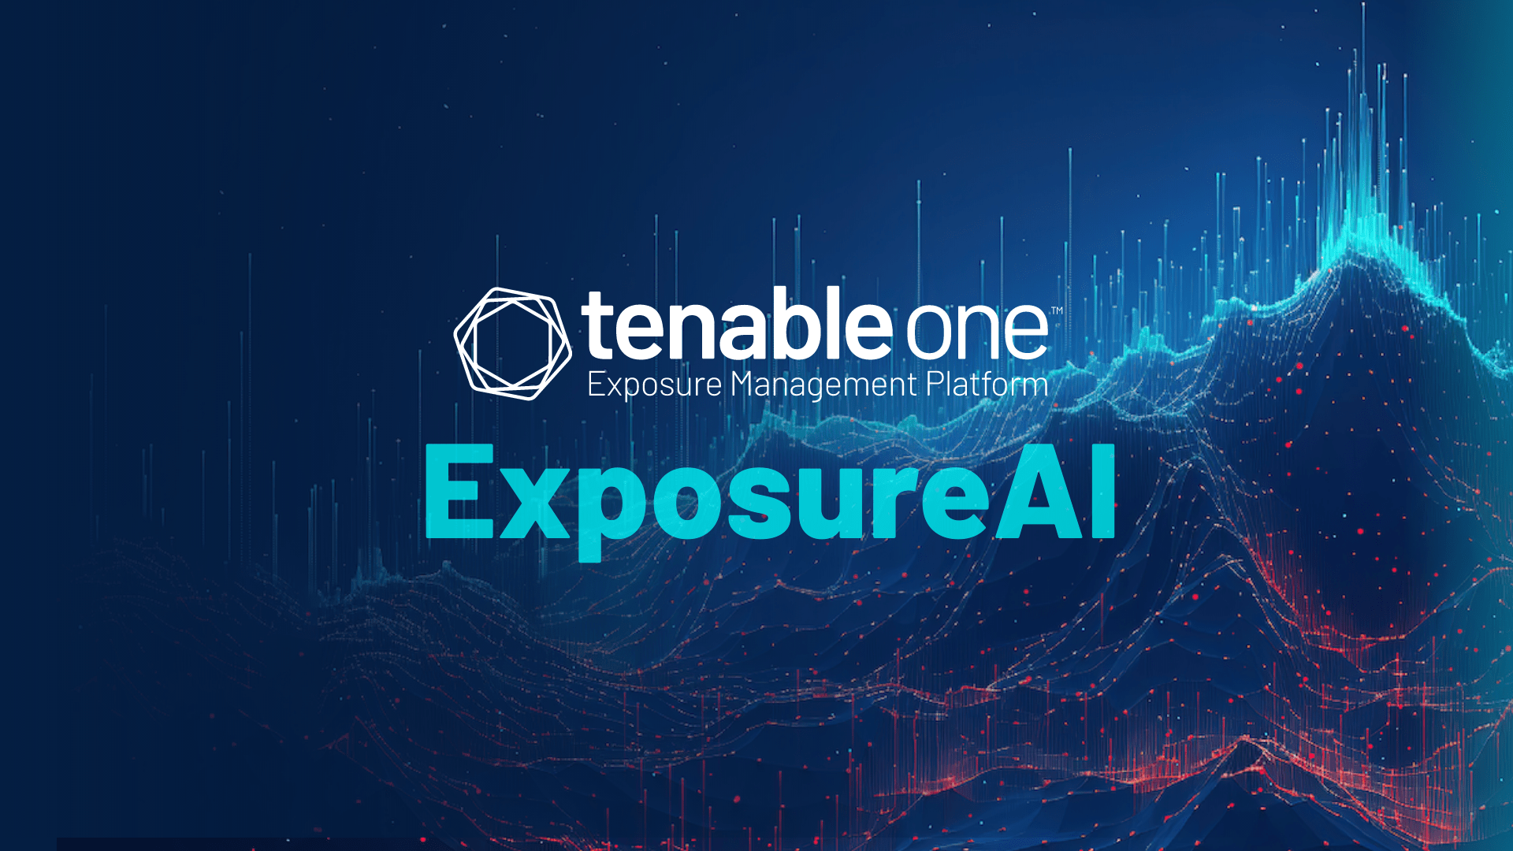
SEARCH
EXPLAIN
ACTION

Slide 8
Introducing Tenable ExposureAI
SEARCH
EXPLAIN
ACTION
Centralized view of all assets to understand contextual relationships, identify security control gaps and prioritize remediation actions.
Overview of all viable attack paths to anticipate the consequences of a cyber attack and preemptively respond to potential threats.
Objective cyber risk scores to show SLA performance, progress over time, peer benchmarking and the ability to drill into departmental units.

Slide 9
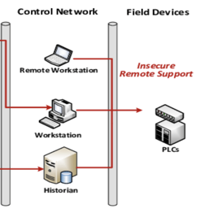
USE ATTACK PATH ANALYSIS FOR BETTER BUSINESS RISK DECISIONS
AD: Domain Admin
Elevation
Joe @ WFH.com
AD: Remote User Group
Authorized Access to App
Stored
Credentials
Two data sets - One major breach pathway detected!
Member
VM: CVE-2021-1566
Ransomware malware CVE
Critical Windows App Server
AD DOMAIN CONTROLLER
VM:
VPN services with no MFA
AD: Trust Relationship Across Domains
Bonus Points:
Privileged Access to Another Domain
(thro(ex. An unprotected VPN vulnerability and an existing AD domain Trust relationship)
Bad Guy @ Organized Crime
Phish to spread ransomware
Critical Industrial Infrastructure
Three data sets - two catastrophic breach pathways detected!
+OT Data Set:
Shows pathways to compromise the entire control network

Slide 10
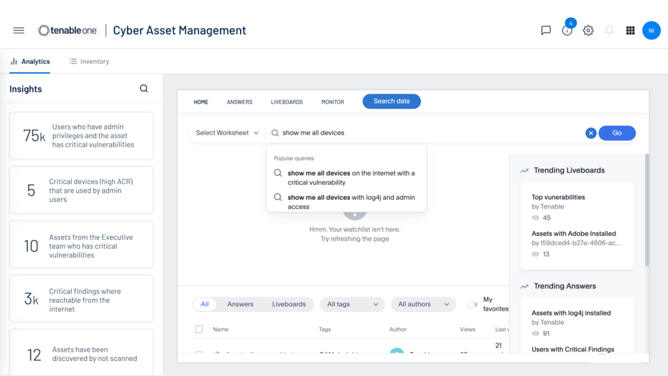
A Look At ExposureAI Use Cases
Search
Simplify Search across your asset inventory for complete visibility
Explain
Derive succinct guidance to better understand product findings
Action
Proactively deliver insights for action with the most impact

Slide 11
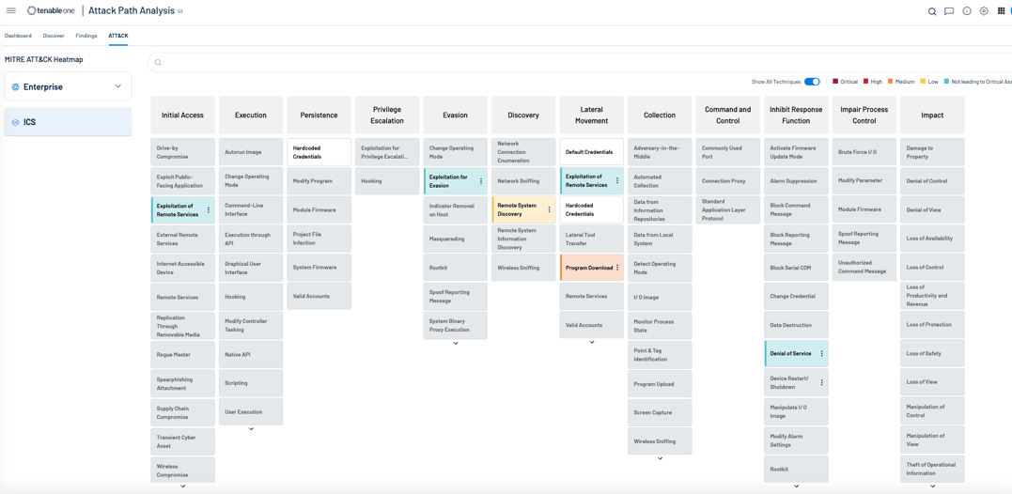
A Look At ExposureAI Use Cases
Search
Simplify Search across your asset inventory for complete visibility
Explain
Derive succinct guidance to better understand product findings
Action
Proactively deliver insights for action with the most impact

Slide 12
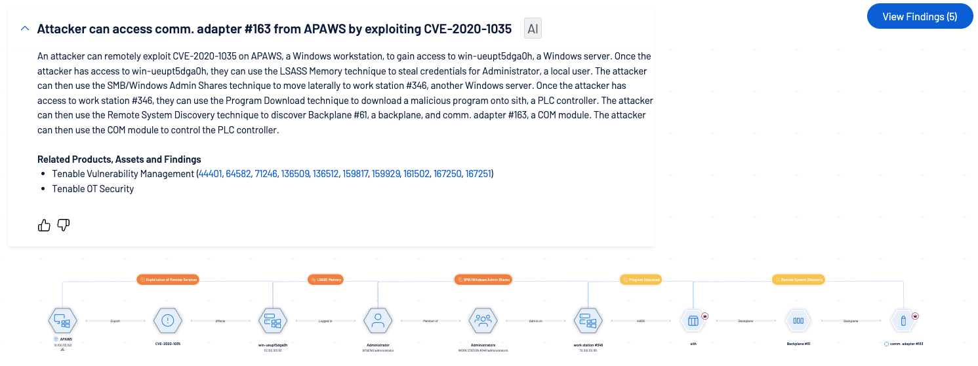
A Look At ExposureAI Use Cases
Search
Simplify Search across your asset inventory for complete visibility
Explain
Derive succinct guidance to better understand product findings
Action
Proactively deliver insights for action with the most impact
Notes:
introduce APA interfect

Slide 13
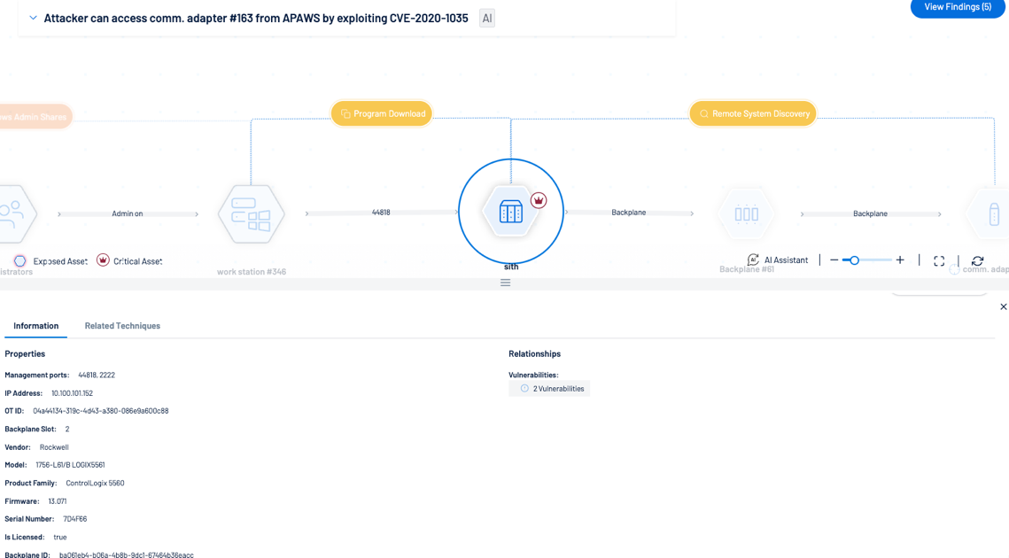
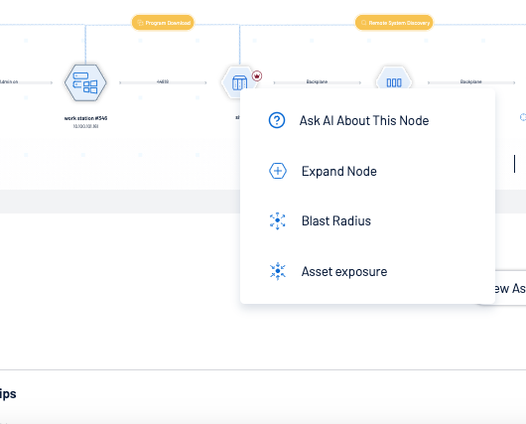
A Look At ExposureAI Use Cases
Search
Simplify Search across your asset inventory for complete visibility
Explain
Derive succinct guidance to better understand product findings
Action
Proactively deliver insights for action with the most impact
Notes:
introduce APA interfect

Slide 14
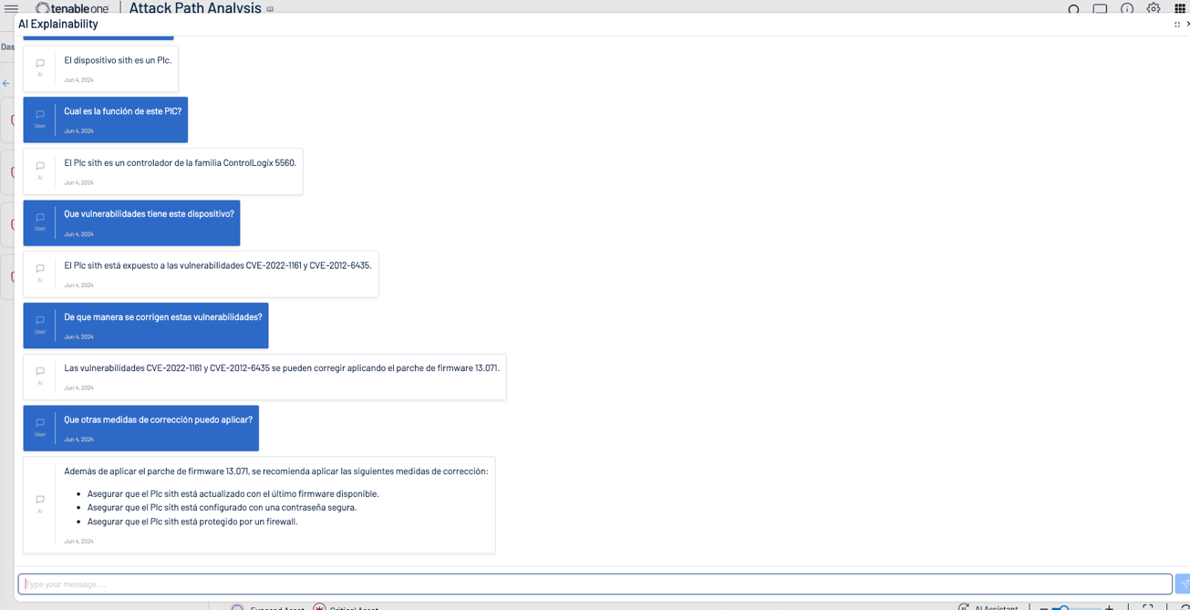
A Look At ExposureAI Use Cases
Search
Simplify Search across your asset inventory for complete visibility
Explain
Derive succinct guidance to better understand product findings
Action
Proactively deliver insights for action with the most impact
Notes:
clicks on an attack path for AI summarization

Slide 15
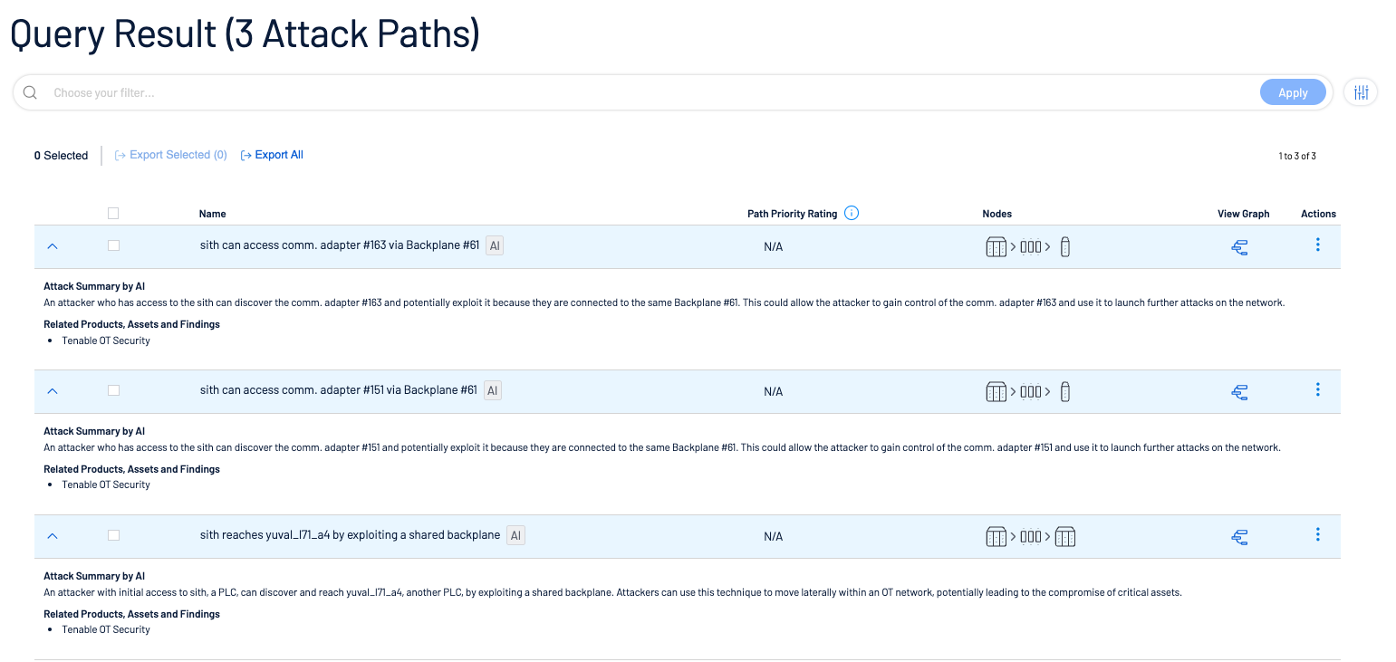
A Look At ExposureAI Use Cases
Search
Simplify Search across your asset inventory for complete visibility
Explain
Derive succinct guidance to better understand product findings
Action
Proactively deliver insights for action with the most impact
Notes:
Visualize and ask node specific questions

Slide 16
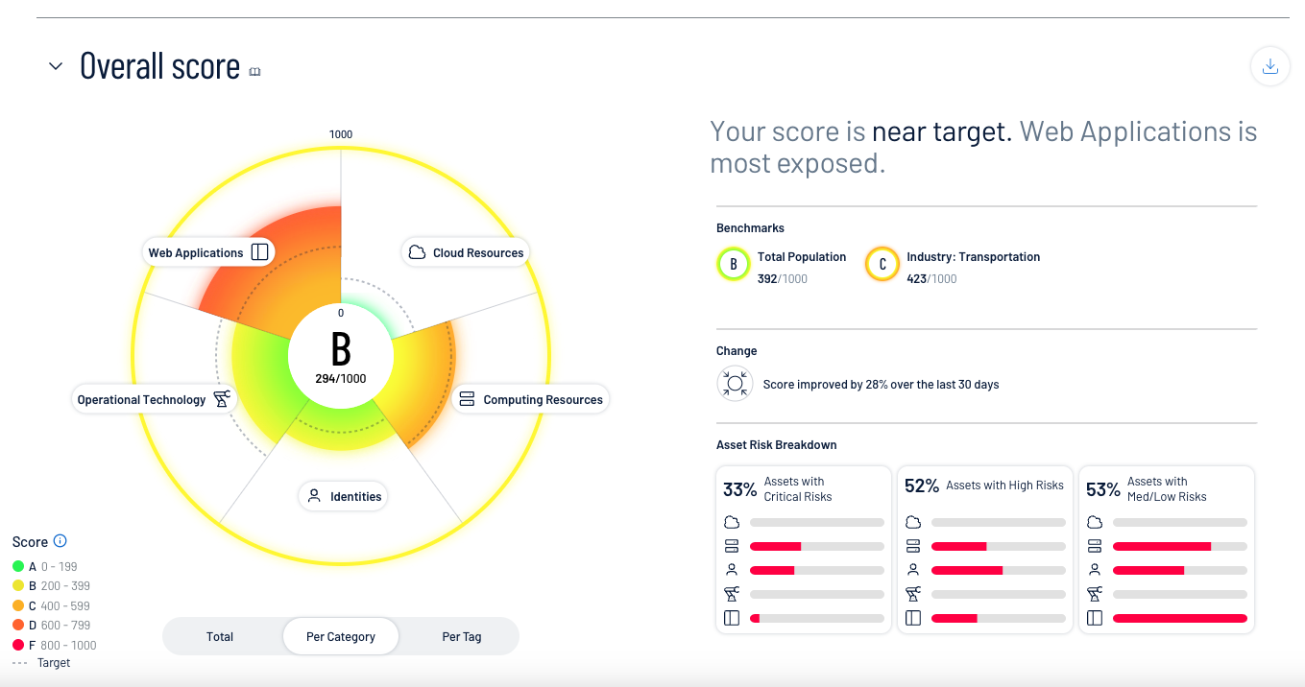
A Look At ExposureAI Use Cases
Search
Simplify Search across your asset inventory for complete visibility
Explain
Derive succinct guidance to better understand product findings
Action
Proactively deliver insights for action with the most impact
Notes:
I feel like in security were just waiting for stuff to happen…. this gives you a fantastic place to start

Slide 17
Want to Learn More?

Slide 18
Thanks!

